Slide 1
Recommender Systems
WKSP 420 Module 1, Lesson 1
Notes:
Welcome to this lesson on Recommender Systems. This is an important application of data science and it is found in many different areas.

Slide 2


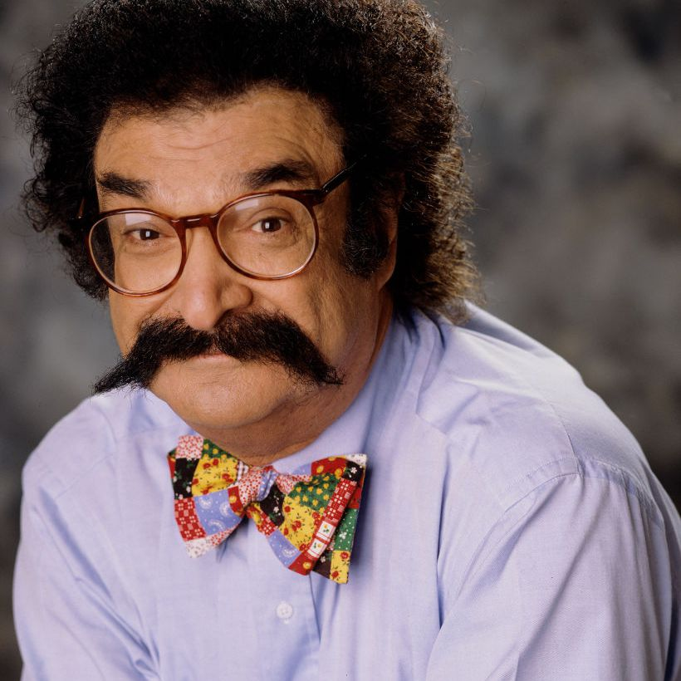
Notes:
Recommender systems are nothing new, though they may have been in forms that you might not recognize at first.
We used to rely on “expert recommenders” in the past. People who were trained to recognize quality in a particular area.
Travel agents used to recommend where to go on vacation.
You could get book recommendations from your local bookstore
A movie critic would tell you what to expect
And many others such as a real estate agent, Food critic, etc.
Expert recommenders have largely declined in recent years in exchange for technology based recommendations that are supposedly free.

Slide 3





Notes:
Most expert recommenders have now been replaced by recommendations from apps that use the “wisdom of the crowd”. That is, getting a lot of experiences from an average and often unqualified user.
So often times on a shopping website, a quick way to see if this is a product you want to try might be by looking at just the number of stars that a particular product received and how many people rated it.
But ask yourself – how did that product get itself in front of you in the first place?
- Underlying recommendation systems are the ones that bring these items to your attention in some prioritized way. That prioritization algorithm is where recommender systems do their work.

Slide 4
Non - Personalized
Semi - Personalized
Personalized
Notes:
I’m largely basing my instruction from the “Practical Recommender Systems” book by Kim Falk. Also for further reference, there is an excellent youtube video called “how recommender systems work” from Art of the Problem which I will include in Canvas.
Another good youtube video: https://youtu.be/ZspR5PZemcs
Recommendations can come in 3 types of flavors.
You can get non-personalized recommendations. So if something is selling really well, that is not based on the preferences of any one user but of the general population overall. So if you were recommended something like a very popular movie that is selling a lot of tickets, then it would be a non-personalized recommendation.
If a recommendation is generated based a certain user group or demographic, that is a semi-personalized recommendation. For example, if men ages 20-29 prefer a certain shaving cream, then that is a semi-personalized recommendation.
If a recommendation is made based on information specific to you, such as Netflix recommending a movie to you based on your viewing habits, then that is a personalized recommendation.

Slide 5
Content Based Filtering
Based on product properties
You “liked” action movies → you get action movie recommendations
Does not allow for variety
Collaborative Filtering
Recommendations based on user profile and similar users’ likes
Your behavior on other sites
Users similar to you also liked this product
Notes:
There are 2 main types of recommender systems
Content based filter is the simpler of the two. It provides you recommendations based on the properties of similar products you liked in the past.
So if you liked a few Action movies, then it will recommend other Action movies with similar properties
This type of recommender does not need to collect information on the user (such as where they live, what they do for work, demographics, etc) or other users to work.
A weakness of this approach is that it can only recommend products similar to what you’ve seen in the past. It can’t recommend items that you have not considered in the past but that you may still like
Collaborative filter is more complex and requires more data.
It uses information on the user’s habits across multiple websites or other parts of their life or their demographics to recommend items that a user of that profile would like
Consider this: People’s taste changes over time and based on their mood. If you can determine this, you can make recommendations that are more current to the user.
It also finds others in the population that are similar to the user, and recommends items that they’ve liked in the past.
The theory here is that people similar to the user may like the same things.
This method is able to recommend things that you may have not considered in the past. This is because it looks a broader set of information.

Slide 6






U1
U2
U3
U4
Notes:
Suppose we’re trying to build a movie recommendation system. There are a number of users, and a number of movies.
Suppose these blue lines represent the movies that each person has ranked. So these are the movies that a person has watched and given a review for.

Slide 7
U1
U2
U3
U4
Notes:
Then the red lines represent all the remaining relationships that have not been ranked by a user. These are the possibilities that the recommender system needs to assess and then recommend the most promising or best prediction.

Slide 8
 |  | 4 |  | 1 | 1
 | 3 | 1 | 2
 |  | 2 | 3 | 1
 |  | 1 |  | 4
U1
U2
U3
U4
Notes:
We can represent those relationships in this matrix format. The Movies are the columns and the users are the row. The numbers are the ratings that the users gave a movie. The blanks are the movies that the user has not rated and what our recommender systems are trying to predict what rating a user will give that movie.

Slide 9
Content Based Filtering
2
Action
1
5
U3
4
Family
User Properties
Movie Properties
Normalized Dot Product = 3
Notes:
In Content based filtering, you take the features of the movies and of the user and combine them to estimate a review. For example, the Little Mermaid could be described as high on the “family” feature, and low on the “action” feature.
Also a user could have their own features like how much they like action and family movies. These are their stated preferences.
Then you can combine both sets of properties, with something like a dot product, to estimate how much the user would like this movie.

Slide 10
Action
4 | 5 | 3 | 5 | 5
2 | 1 | 4 | 2 | 2
Family
Action
Family
3 | 1
2 | 2
4 | 4
1 | 5
U1
U2
U3
Matrix
Multiply
U4
Notes:
You can represent these features for all the users and all the movies in matrix form. These matrices are the factor matrices and you can do a simple matrix multiply to get the estimated rating matrix.
You can also use metadata about the items and users as features.

Slide 11
Action
4 | 5 | 3 | 5 | 5
2 | 1 | 4 | 2 | 2
Family
Action
Family
3 | 1
2 | 2
4 | 4
1 | 5
1.5 | 2 | 1 | 0.5 | 2
1 | 1 | 1.25 | 1.25 | 1.25
3 | 3 | 3.75 | 3.75 | 3.75
1 | 0 | 3 | 4 | 1
U1
U2
U3
U4
Notes:
As shown here (the estimated rating matrix)

Slide 12
Action
4 | 5 | 3 | 2 | 5
2 | 1 | 4 | 5 | 2
Family
Action
Family
3 | 1
2 | 2
4 | 4
1 | 5
1.5 | 2 | 1 | 0.5 | 2
1 | 1 | 1.25 | 1.25 | 1.25
3 | 3 | 3.75 | 3.75 | 3.75
1 | 0 | 3 | 4 | 1
U1
U2
U3
U4
Notes:
Then for a given user, say U4, recommend to him the movie with the highest estimated score. In this case, User 4 had a strong preference for family movies and the recommender system suggested the Little Mermaid.

Slide 13
Some Gotchas
Action
Horror
U1
U2
Notes:
Now, because this is a simplistic algorithm, there are some drawbacks.
One of these is that there is No consistency in the movie label between users. One user may see this movie as an action genre, and another might label it as a horror movie. If you ask them to rank how much this movie is an “Action” movie from 1 to 5, you might get different scales based on a user’s experience with Action movies they watched in the past.
This is common to all surveys. One person’s 5-stars is another person’s 4-stars. There are some normalization methods that can be employed to reduce this effect.

Slide 14




User Rating is Mood Dependent
Notes:
The mood you are in when you rate a particular feature will influence your rating.
This is a very practical effect. If you’re in a good mood due to something in your life that may be unrelated, and you watch a particular movie, you might give it a higher rating than if you were watching while in bad mood.
There is a lot of variability in how people rank things, and content-based filtering does not account for much of that.

Slide 15
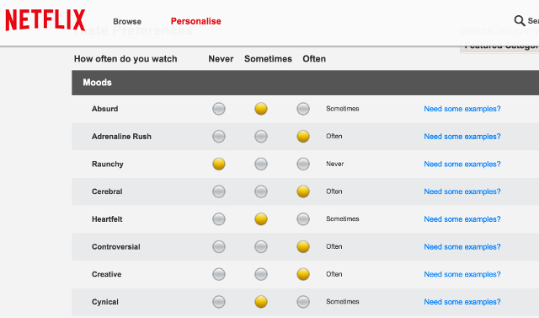
Need for surveys
Notes:
Netflix used to require users to fill out lengthy surveys to get a sense for what they liked.
Cons:
Tedious
Snap-shot in time. User taste could evolve or be different if they are in a different mood.
Users aren’t always good at describing what they like
So to advance on content based filtering, we will next look at how collaborative filtering can do a better job.

Slide 16
Collaborative Filtering
Notes:
Let’s get into collaborative filtering that is a more advanced method that can overcome some of the limitations of Content Based Filtering.
We’ll go over two types of collaborative filtering which build on each other.

Slide 17
Memory Based
 | 3 | 1 | 2 | 1 | 1
 | 3 | 1 | 2 |  | 1
 |  | 2 | 3 | 1
 |  | 1 |  | 4
U1
U2
U3
U4
Notes:
In the first type of collaborative filtering, which is called memory based collaborative filtering, we look at similar users to predict what a customer will rate a given product. In this example, we see that User 1 and 2 vote identically for all of the movies. So the recommender might learn that these two users are similar, and that user 2 will likely vote the Little Mermaid as a 1 because that’s what user 1 did.
Normally, users are not identical like this, but they can be similar. So we need a similarity metric to determine how close users are to each other.

Slide 18
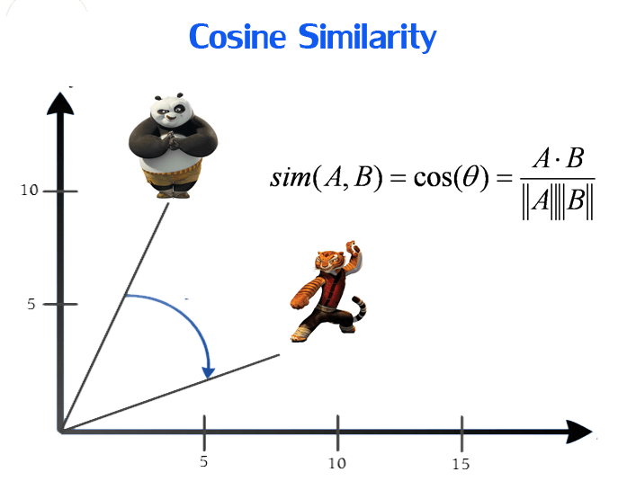
Cosine Similarity
Notes:
Two users are represented by vectors. Then the cosine of the angle between them is a measure of how similar the users are to each other. Smaller angle means more similar.
Image from https://dataaspirant.com/five-most-popular-similarity-measures-implementation-in-python/

Slide 19

Cosine Similarity
$similarity=\frac{a.b}{\left|\left|a\right|| \left||b\right|\right|}$
$\vec{a}= \left[\begin{matrix}4 \\ 3\end{matrix}\right]$, $\vec{b}= \left[\begin{matrix}5 \\ 5\end{matrix}\right]$
$a.b=\left(4×5\right)+\left(3×5\right)=35$
$\left|\left|a\right|| \right|=\sqrt{4^{2}+3^{2}}=5$
$\left|\left|b\right|| \right|=\sqrt{5^{2}+5^{2}}=5\sqrt{2}$
$similarity=\frac{35}{5×5\sqrt{2}}=0.989$
Notes:
Let’s go through a simple example on how to calculate cosine similarity.
Say user A’s recommendations result in vector (4,3). And user B’s recommendations result in vector (5,5).
So we can calculate the cosine similarity as follows (go through the bullets).
So again, a smaller angle between vectors means they are more similar to each other.

Slide 20
K Means + Cosine
1. Learn clusters of similar users
2. Compute cosine only to users in same cluster
User
1
2
Cluster
3
4
Notes:
Often times you have a large number of users and products. Rather than trying to compute the similarity between all of them, use an unsupervised learning algorithm such as K-Means to first cluster the users into groups. These are groups of similar users.
Then within each group, calculate the cosine similarity. So we’re doing some filtering first with the K-means to find users that are somewhat similar. Then we refine that by calculating the cosine similarity between the members of the same group.

Slide 21
Other Relationships
 | 3 | 1 | 1 | 3 | 1
 | 1 | 2 | 4 | 1 | 3
 | 3 | 1 | 1 | 3 | 1
 | 4 | 3 | 5 | 4 | 4
U1
U2
U3
U4
Notes:
Let’s look at our recommendation matrix and see the types of relationships that may exist. First off, if we see columns that are similar or equal, that indicates that the general public feels that these movies are related. You usually see this in the case of movie sequels for example.

Slide 22
Other Relationships
 | 3 | 1 | 1 | 3 | 1
 | 1 | 2 | 4 | 1 | 3
 | 3 | 1 | 1 | 3 | 1
 | 4 | 3 | 5 | 4 | 4
U1
U2
U3
U4
Notes:
This is a more advanced relationship.
Here the sum of user 2 and 3 is user 4. This happens when user 2 and user 3 have their own independent tastes, and user 4 likes both of their preferences.
Although this sounds very fictional, this can happen quite often as our tastes are often a combination of many different influences.

Slide 23
??
? | ? | ? | ? | ?
? | ? | ? | ? | ?
Latent Features
??
??
??
? | ?
? | ?
? | ?
? | ?
? | 2 | ? | 2 | 0
3 | 2 | 1 | ? | ?
? | 4 | 2 | 2 | ?
? | 2 | ? | 2 | ?
U1
U2
U3
U4
Notes:
There are a lot of different ways in which rows and columns can be related. In the 2nd method of Collaborative Filtering known as Model-based learning, we first remove the labels from the features. We basically let the learning algorithm find out the custom categories for the user and item matrices. That’s why they are called latent features.
So for the machine learning algorithm, the already existing user ratings (in yellow) act like the training data. It will then try different combinations of values for the factor matrices until it gets to one that most closely reproduces the training data when they are matrix multiplied.

Slide 24
Stochastic Gradient Descent
c(w)
Cost function
Learning Rate
w_min
w
Notes:
The algorithm can use different methods to find the best factors. One is Stochastic Gradient Descent.
As a refresher, Gradient Descent is where you pick a concave cost function. Here we have the Mean Square Error. Because it’s “Square”, the function is concave, so there is a minimum or optimal value. You don’t know what that is in the beginning so you start at some random point on the curve. Then you take the derivative of the cost function and you use the direction of that derivative to determine where to take the next step. And you keep taking little steps until you get to the minimum value. This value is where you have the lowest estimation cost.
The learning rate is the size of the step. If you take too small a step, then you need to iterate a lot if times before you get to the optimum value. If you take too large a step then you’ll overshoot the target and probably have to come back around to find it.
It’s “stochastic” because the algorithm will take a random sampling from the training set to do the gradient update. This allows it to remain efficient even if you have a very large matrix.
Now you should note that there are many other types of optimization algorithms out there and this is just one.

Slide 25
??
? | 2 | ? | ? | ?
? | 3 | ? | ? | ?
Latent Features
??
??
??
? | ?
4 | 5
? | ?
? | ?
? | 2 | ? | 2 | 0
3 | 2 | 1 | ? | ?
? | 4 | 2 | 2 | ?
? | 2 | ? | 2 | ?
U1
U2
U3
U4
Notes:
So let’s look at this particular value which is the convergence of the user 2 and movie 2 latent features. So with gradient descent, you’ll start with some random numbers as the latent features for user and movie. Then that will lead to some error. Then you’ll use gradient descent to figure out how to update the latent feature numbers and try again, until you reach a set of numbers for each latent feature that get you pretty close to 2.

Slide 26
??
? | 3 | ? | ? | ?
? | 2 | ? | ? | ?
Latent Features
??
??
??
? | ?
2 | 1
? | ?
? | ?
? | 2 | ? | 2 | 0
3 | 2 | 1 | ? | ?
? | 4 | 2 | 2 | ?
? | 2 | ? | 2 | ?
U1
U2
U3
U4
Notes:
Then you’ll repeat this for each of the user ratings in the training set.

Slide 27
??
4 | 3 | 2 | 2 | 3
1 | 2 | 3 | 2 | 1
Latent Features
??
??
??
1 | 3
2 | 1
3 | 1
1 | 3
0 | 2 | 4 | 2 | 0
3 | 2 | 1 | 1 | 2
6 | 4 | 2 | 2 | 4
0 | 2 | 4 | 2 | 0
U1
U2
U3
U4
Notes:
Then when I get those optimized latent features, I multiply them together to get the missing values. These are then the predictions of the recommender system.

Slide 28
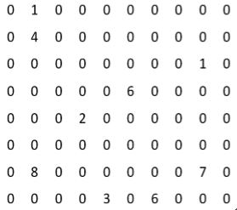
Beware the Sparse Matrix
Notes:
One of the drawback of this method is that there are a lot of users and a lot of products. But most people don’t rate most products.
So you often get a very sparse matrix. This now becomes very difficult to use for predictions because there’s just not a lot of training data here.

Slide 29



Implicit Features
Notes:
You may not always get a lot of direct feedback from users. So, companies use implicit features to infer interest. For example, whether hit the subscribe button, whether you put something in a shopping cart even if you don’t buy it, where your eye is landing on the web page or linger time on a part of the web-page.
The advantage is there is a lot of implicit data out there, but the downside is that this data is noisy. You’re not always sure if these features mean what you think they do. So you have to be careful.

Slide 30
Collaborative Filtering
Novel recommendations
No need for large surveys
Computationally efficient
Sparse matrix
Notes:
Pros of collaborative filtering include the recommender being able to recommend movies from categories that the target user has not watched before. For example, they may have never seen a horror movie, but people similar to them liked horror movies, so the algorithm might recommend a horror movie.
Also, you don’t need to have large surveys for each user. This is important because people don’t usually fill out surveys well.
As matrices grow, you get more and more benefit from breaking down a large matrix into two smaller factor matrices.
One weakness is that matrices can be very sparse. Most users don’t rate most movies. So you need to use implicit features to get more dense matrices.

Slide 31
Summary of Methods
Content Based Filtering:
“You liked product A, so you might like product B”
Collaborative Filtering:
“You are similar to this other user who like product A, so you might like product A too”

